Slide 1
Support for Qualitative Visualization
Data Visualization Services Community of Practice
April 25, 2025

Slide 2
Qualitative Data What has come your way?
What types of qualitative data have people brought you looking for help with visualization? (surveys, photos, audio interviews)
https://www.menti.com/alvwvqxw8esz
Notes:
https://www.mentimeter.com/app/home

Slide 3
Qualitative Data What has come your way?
What types of qualitative data have people brought you looking for help with visualization? (surveys, photos, audio interviews)
Have there been specific visualization outputs that people been wanting help with for qualitative projects? (timelines, infographics, networks/trees)
https://www.menti.com/alvwvqxw8esz

Slide 4
John’s Qualitative Visualization Session
Intro Data Vis session didn’t feel like a fit for scholars with qualitative data
Excluded: Surveys, InfoGraphics, NVIVO
Aimed to be a 60-minute intro / overview. Trigger some ideas and tools to get people started.
Invitation to consult on a project.

Slide 5
Start of Run Through Please Interrupt

Slide 6
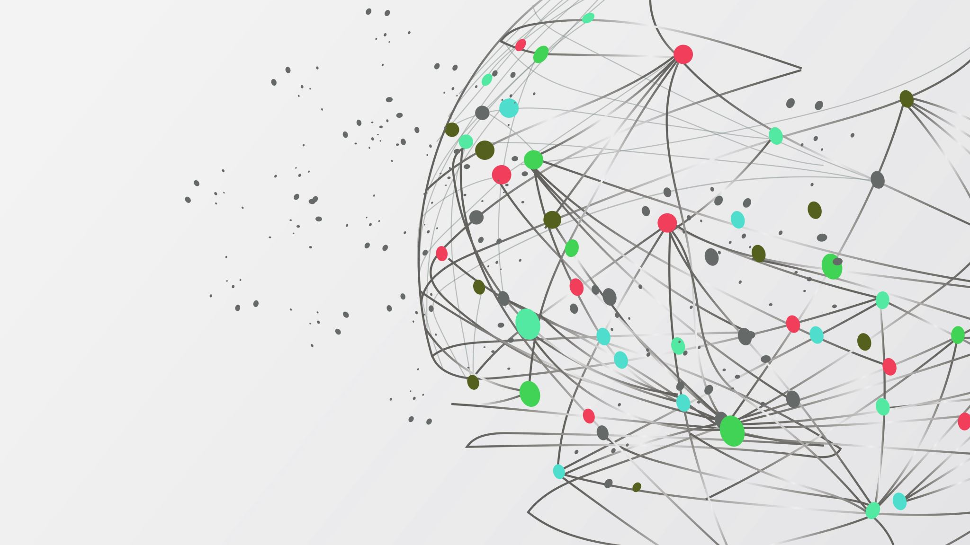
Visualization for Qualitative Data (Speed run for DV CoP)
John Brosz, PhD
Data and Visualization Curator
Libraries & Cultural Resources
Slides: brosz.ca/slides

Slide 7
The University of Calgary, located in the heart of Southern Alberta, both acknowledges and pays tribute to the traditional territories of the peoples of Treaty 7, which includes the Blackfoot Confederacy (comprised of the Siksika, the Piikani, and the Kainai First Nations), the Tsuut’ina First Nation, and the Stoney Nakoda (including the Chiniki, Bearspaw, and Goodstoney First Nations). The City of Calgary is also home to the Métis Nation of Alberta (Districts 5 and 6).

Slide 8
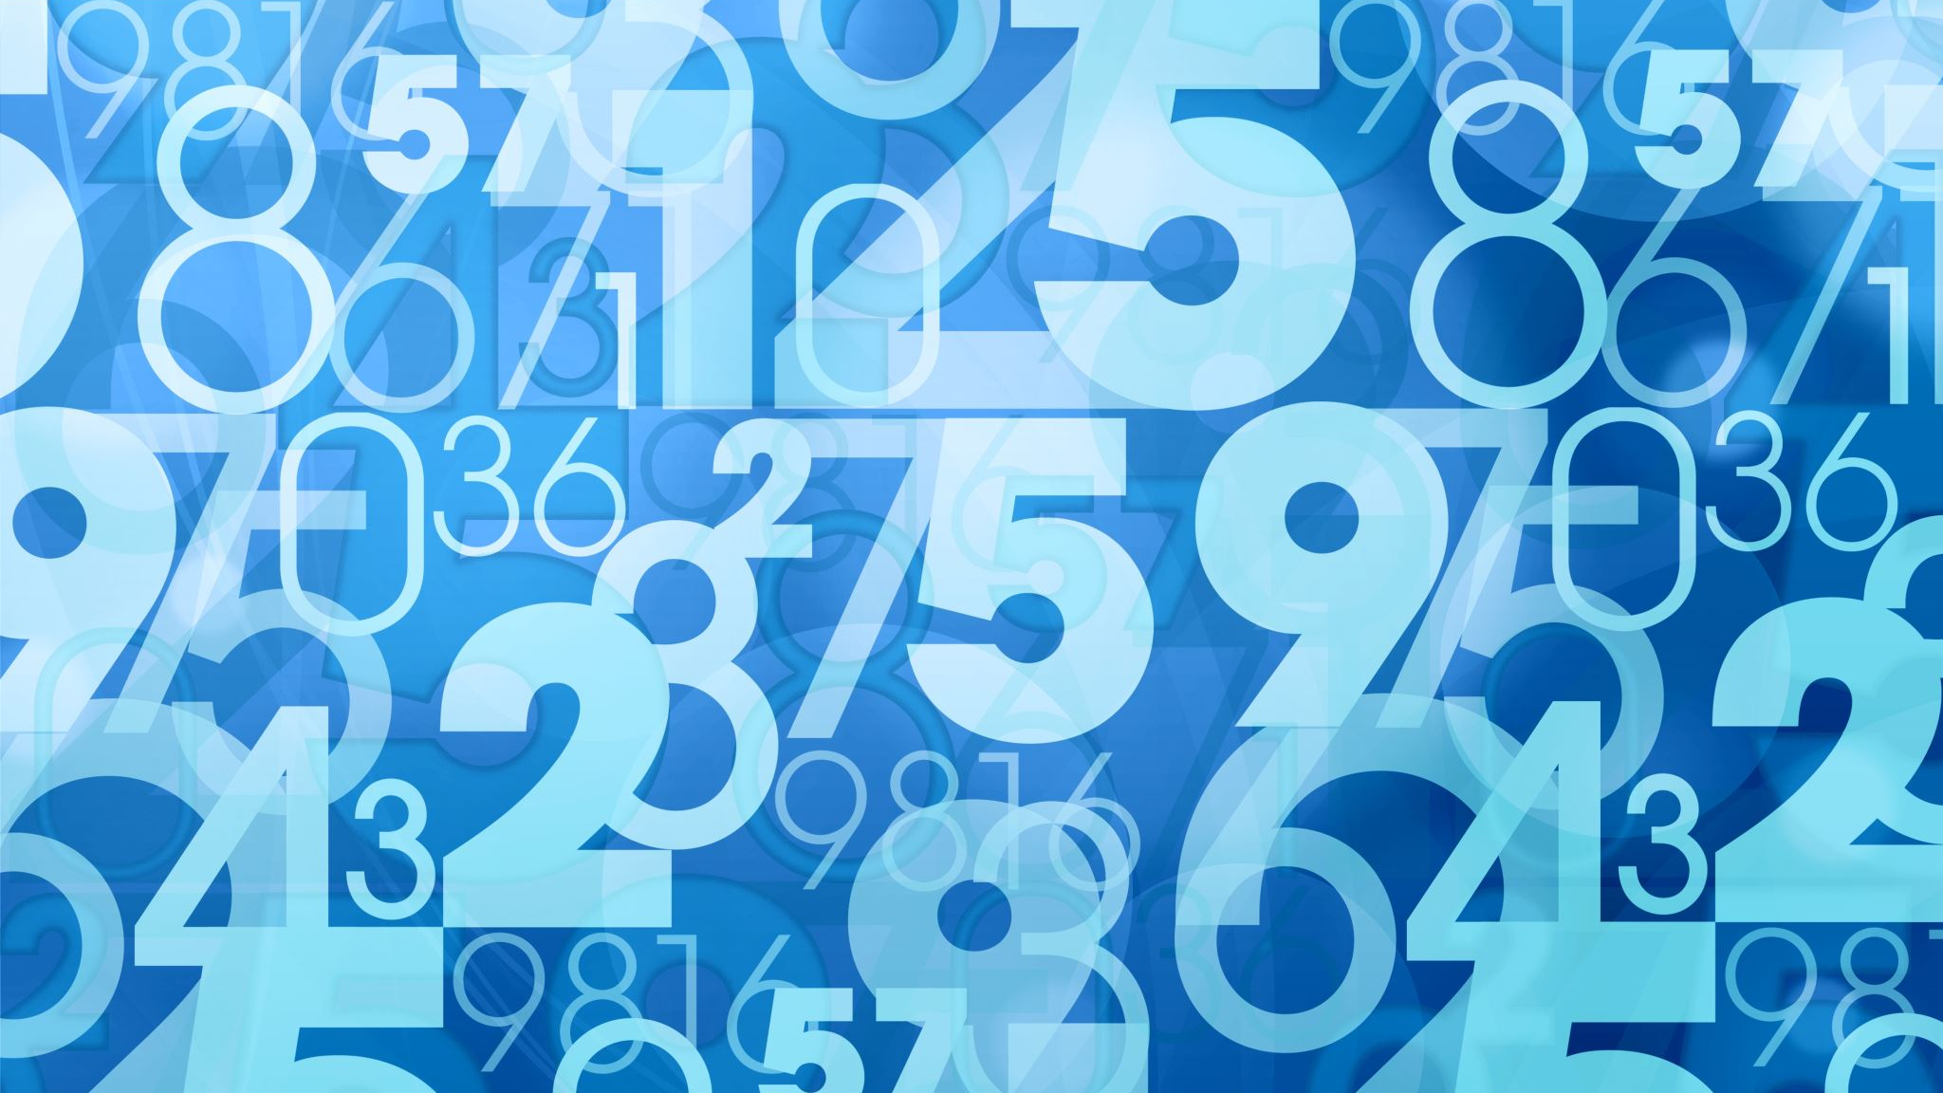
I want to visualize my data but it is not made up of numbers
Qualitative Visualization
Slides: brosz.ca/slides

Slide 9
Topics
Qualitative Data
Visualization
Techniques
Coloured Text/Heatmaps
Hybrid Qual/Quant
Word Clouds
Sets – Venn & Upset
Timelines
Graphs/Networks, Trees

Slide 10
Qualitative Data
Data that is non-numerical in nature. Collected through observations, interviews, focus groups, written records & notes, and similar methods.
Interviews
Observations
Narratives & stories
Documents
Diaries
Photographs or other Audio & Video recordings
Processes / Relationships

Slide 11
Qualitative Data What’s Different?
Not as simple as dumping data into software
Framing is critical
Impact of stories versus numbers

Slide 12
Finding Qualitative Datasets
UK Data Service
https://beta.ukdataservice.ac.uk/datacatalogue Offers a Data Type filter for Qualitative and Mixed Methods data
The Syracuse Qualitative Data Repository
https://data.qdr.syr.edu/
Kaggle - https://www.kaggle.com/
Data science focus, but has some qualitative data as well E.g., Kentucky animal bites dataset https://www.kaggle.com/datasets/rtatman/animal-bites
Sage Research Methods
https://methods.sagepub.com/datasets
Interview transcripts, drawings, images, letters, log files, diary entries, case notes, audio, reflexive notes visual art pieces

Slide 13
Data Visualization & Qualitative Data
Two approaches
Techniques designed for qualitative data
Count things (codes, groups, categories) and use quantitative visualization techniques.

Slide 14
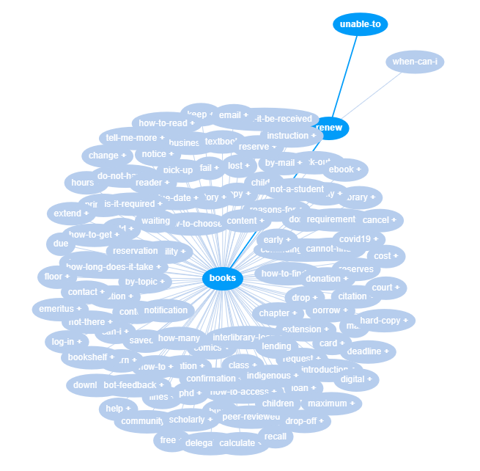
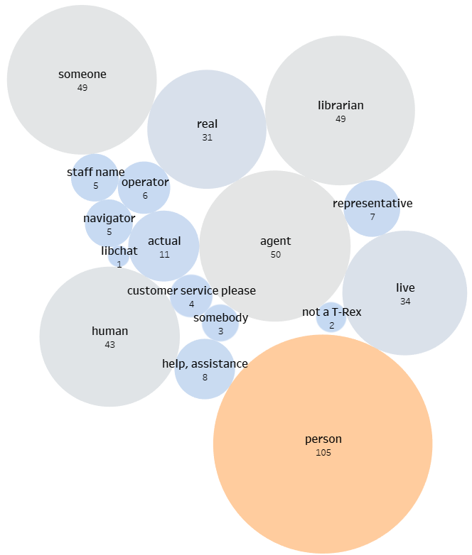
Techniques designed for qualitative data
Count & use quantitative techniques
“Why can’t I renew my books?”
Chat text related to requesting a live chat operator

Slide 15
Data Visualization Definitions
Visual representation of data
“Transformation of the symbolic into the geometric“ [McCormick et al, 1987]
“… artificial memory that best supports our natural means of perception” [Bertin, 1967]
“Use of computer-generated, interactive, visual representations of data to amplify cognition” [Card, Mackinlay, & Shneidermann, 1999]

Slide 16
Why do we visualize data?
Amplify cognition

Slide 17
Amplify Cognition
Paradoxes – Lewis Carroll
Paradoxes – Epimenides
Paradoxes – Self-ref
Paradoxes – Infinity
Epimenides – Self-ref
Epimenides – Tarski
Halting Problem – Decision Procedure
Halting Problem – Turing
Infinity – Halting problem
Infinity – Recursion
Infinity – Zeno
Infinity – Lewis Carroll
Zeno – Lewis Carroll
Lewis Carroll – Wordplay
Tarski – Epimenides
Tarski – Truth vs Provability
Tarski - Undecidability

Slide 18
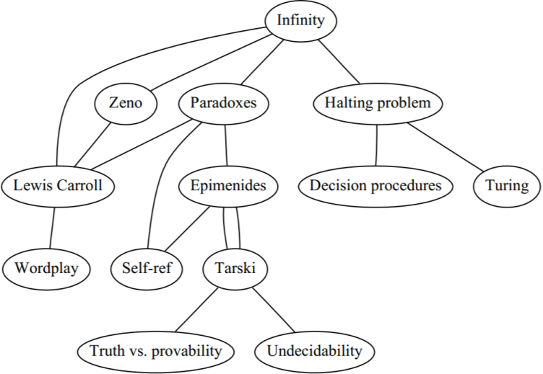
Amplify Cognition

Slide 19
Why do we visualize data?
Amplify cognition
Sometimes just break up text
Different outlook on your data
No better way to find data problems

Slide 20
Visualization Building Blocks
Encoding
Marks: Colour, Lightness, Size, Position, Orientation, Shape, Motion, Texture
Relationships between marks: Connections & Containment
Purpose, Audience, Medium, Goal/Story, Data Properties
Visual Cortex vs Cerebral Cortex

Slide 21
Purpose
Exploratory
Increase your understanding
Find patterns
Reflect your way of thinking
Explanatory
Capture attention
Increase speed of understanding
Maximize memorability
Stimulate action

Slide 22
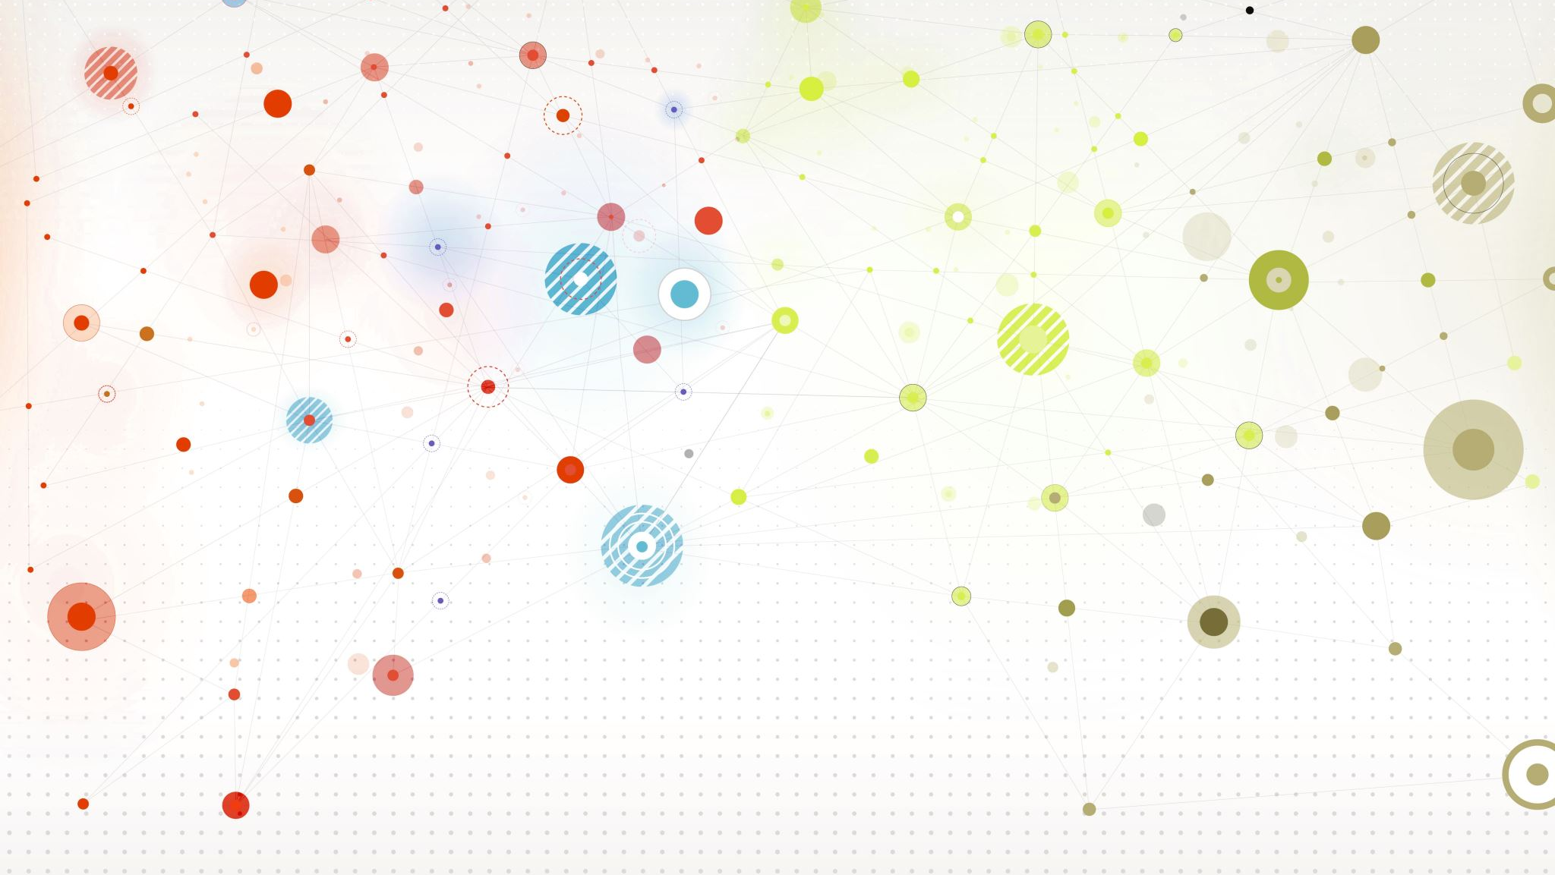
Charts & Techniques
Text Extracts & Colours
Mixing Quantitative & Qualitative
Word Clouds
Venn Diagrams
Timelines
Networks & Graphs
Trees & Hierarchies

Slide 23
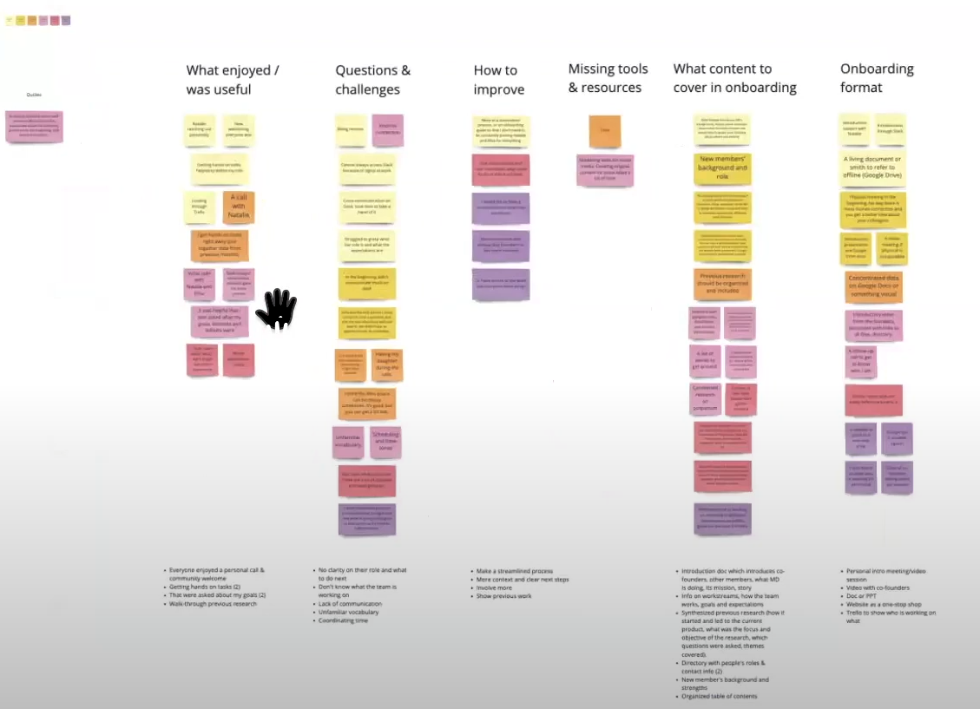
Extracted, Grouped, and Coloured Text
https://miro.com/index/
Mural is another useful, similar app https://www.mural.co/

Slide 24
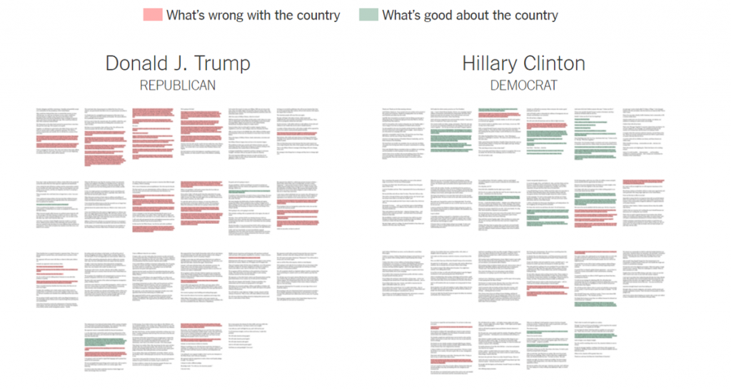
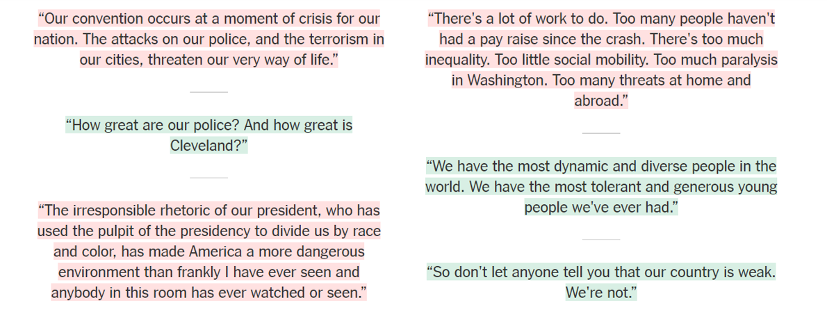
https://www.nytimes.com/interactive/2016/07/29/us/elections/trump-clinton-pence-kaine-speeches.html

Slide 25
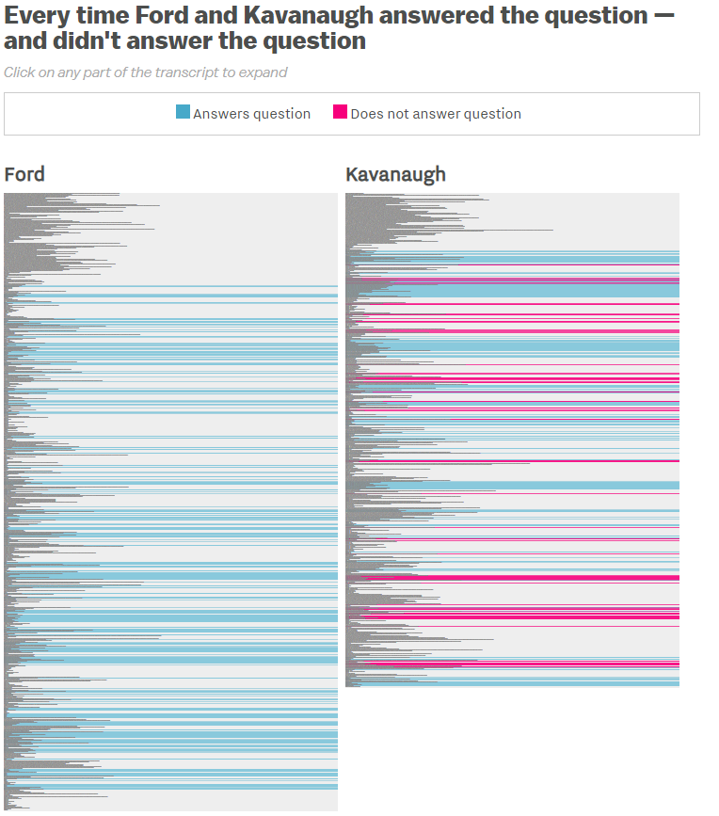
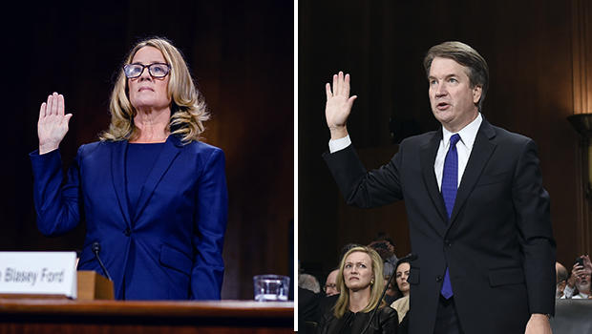
https://www.vox.com/policy-and-politics/2018/9/28/17914308/kavanaugh-ford-question-dodge-hearing-chart

Slide 26
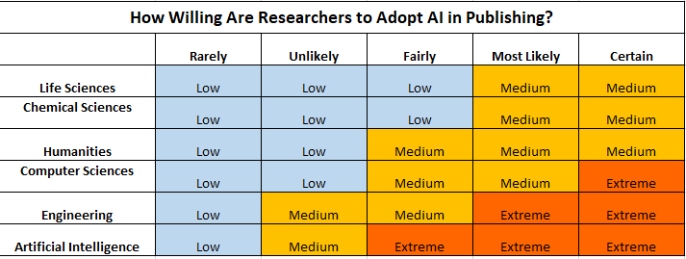
From https://www.enago.com/academy/data-visualization-techniques-qualitative-research/

Slide 27
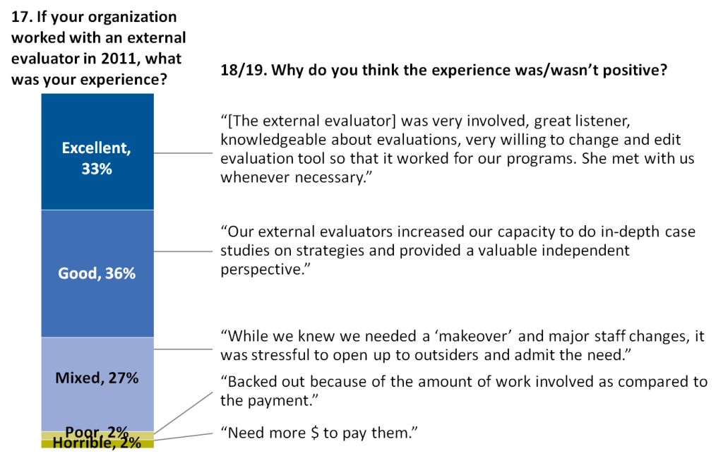
Mix Quantitative & Qualitative

Slide 28
From https://www.storytellingwithdata.com/blog/2018/10/10/three-tips-for-storytelling-with-qualitative-data

Slide 29
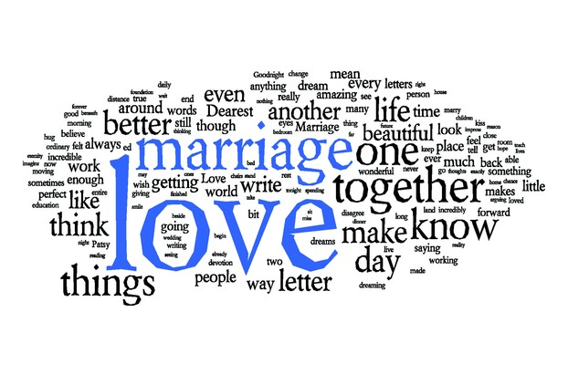
Word Cloud aka Tag Cloud, Wordle
Collection of words, often sized by importance or frequency.
May also incorporate colour to highlight or reflect another value.
Memorable, engaging, and easy to read.
Conveys a general impression, not exact values.
Useful for quick group reflection on crowdsourcing, surveys, quizzes, summaries, or feedback.

Slide 30
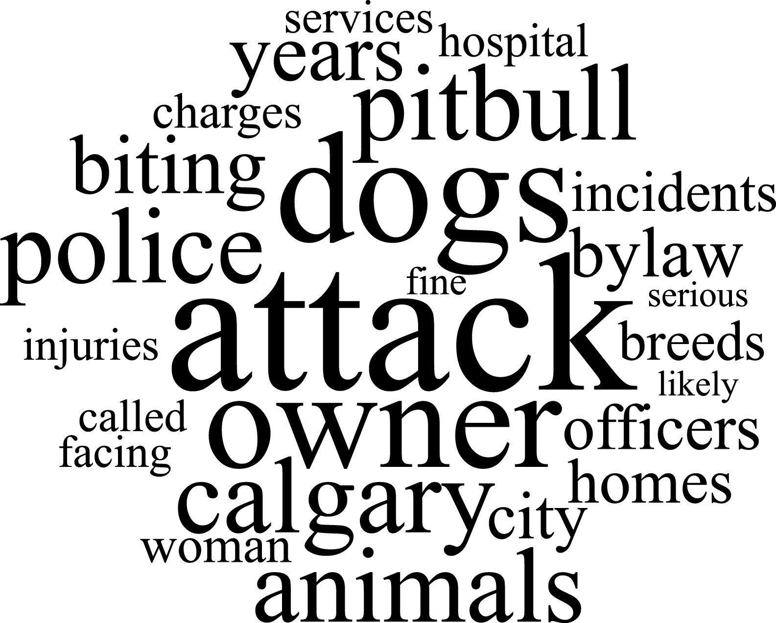
25 most-frequently used words in a collection of media reports
From: Mouton, M., Boulton, A., Solomon, O., & Rock, M. J. (2019). ‘When the dog bites’: What can we learn about health geography from newspaper coverage in a ‘model city’ for dog-bite prevention? Health & place, 57, 70-73.
DOI: 10.1016/j.healthplace.2019.03.001

Slide 31
https://www.americanprogressaction.org/

Slide 32
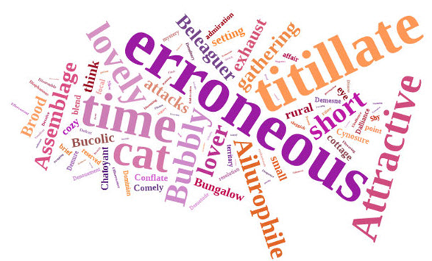
Word Cloud
Considerations
Beware of random colours
Pick easy to read fonts
Stop words & synonyms
Use important/unique words
Context is removed
Can be overused

Slide 33
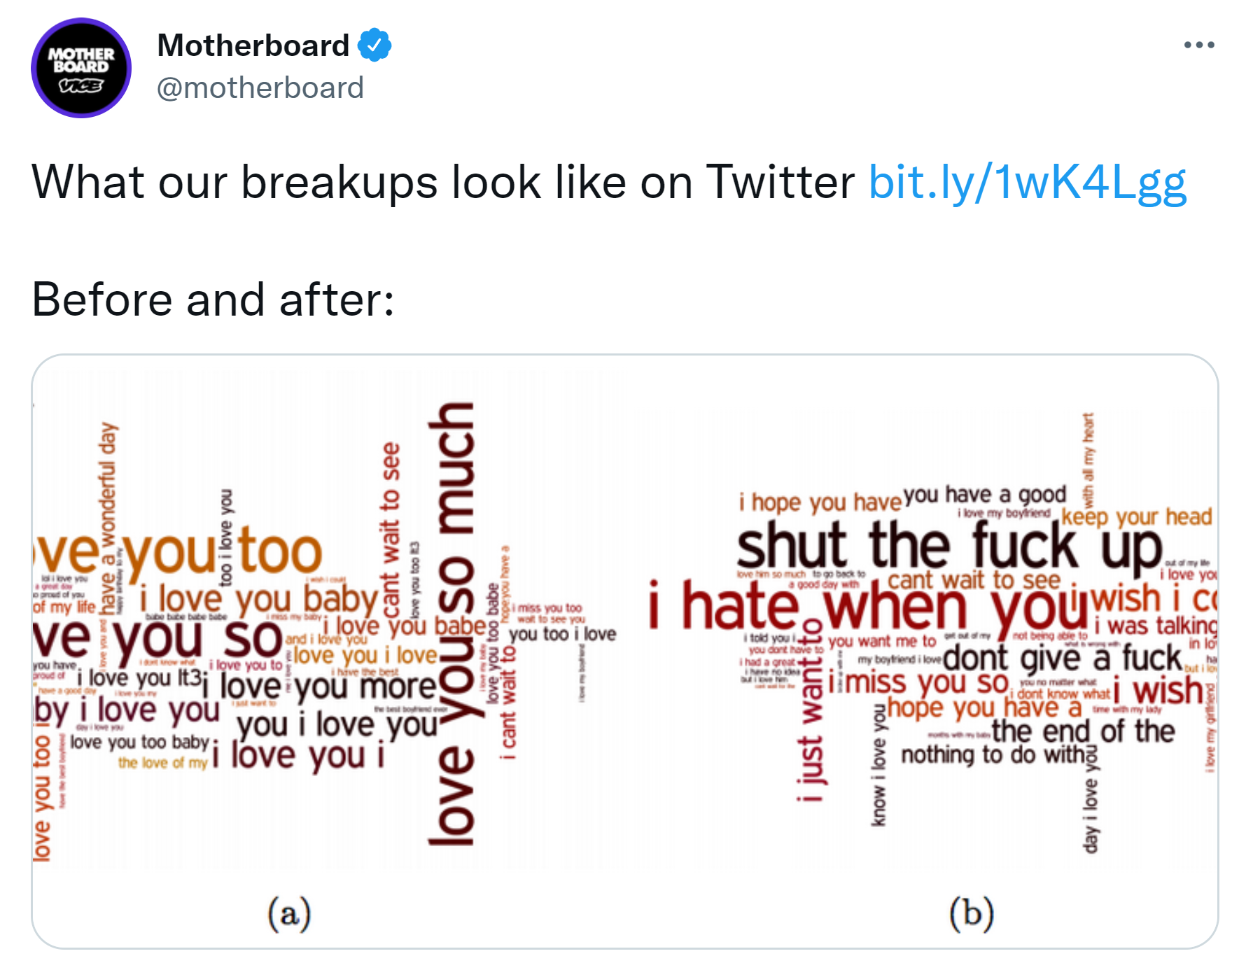
Word Cloud
Simply looking at how often a word or phrase appears in your dataset is not a sufficient way to analyze your data!
Be intentional. Example: add a question to your interview like what one word would you use to describe __________?

Slide 34
Word Cloud Generators
EdWordle http://www.edwordle.net/index.html Basic, simple to use word cloud.
Jason Davies Word Cloud Generator https://www.jasondavies.com/wordcloud/ Simple & web-based; has orientation controls.
Word Art https://wordart.com/create Manually specify word size, fit cloud to shapes.
word_cloud https://github.com/amueller/word_cloud Python library for coding your own word cloud.
Voyant https://voyant-tools.org/ Provides a variety of visualizations for text analysis, including word clouds.

Slide 35
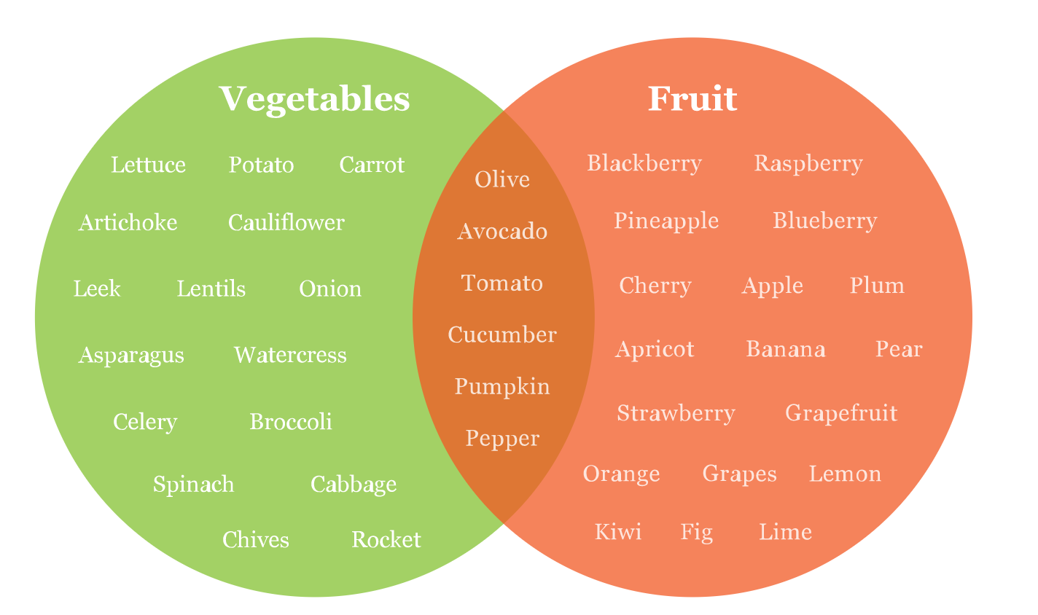
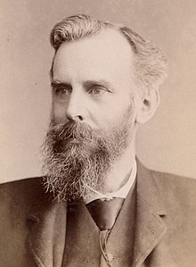
Venn Diagram aka Set Diagram
Intersection area can vary.
Some diagrams make the circles different sizes to reflect number of elements in each set.
Created in 1880 by John Venn

Slide 36
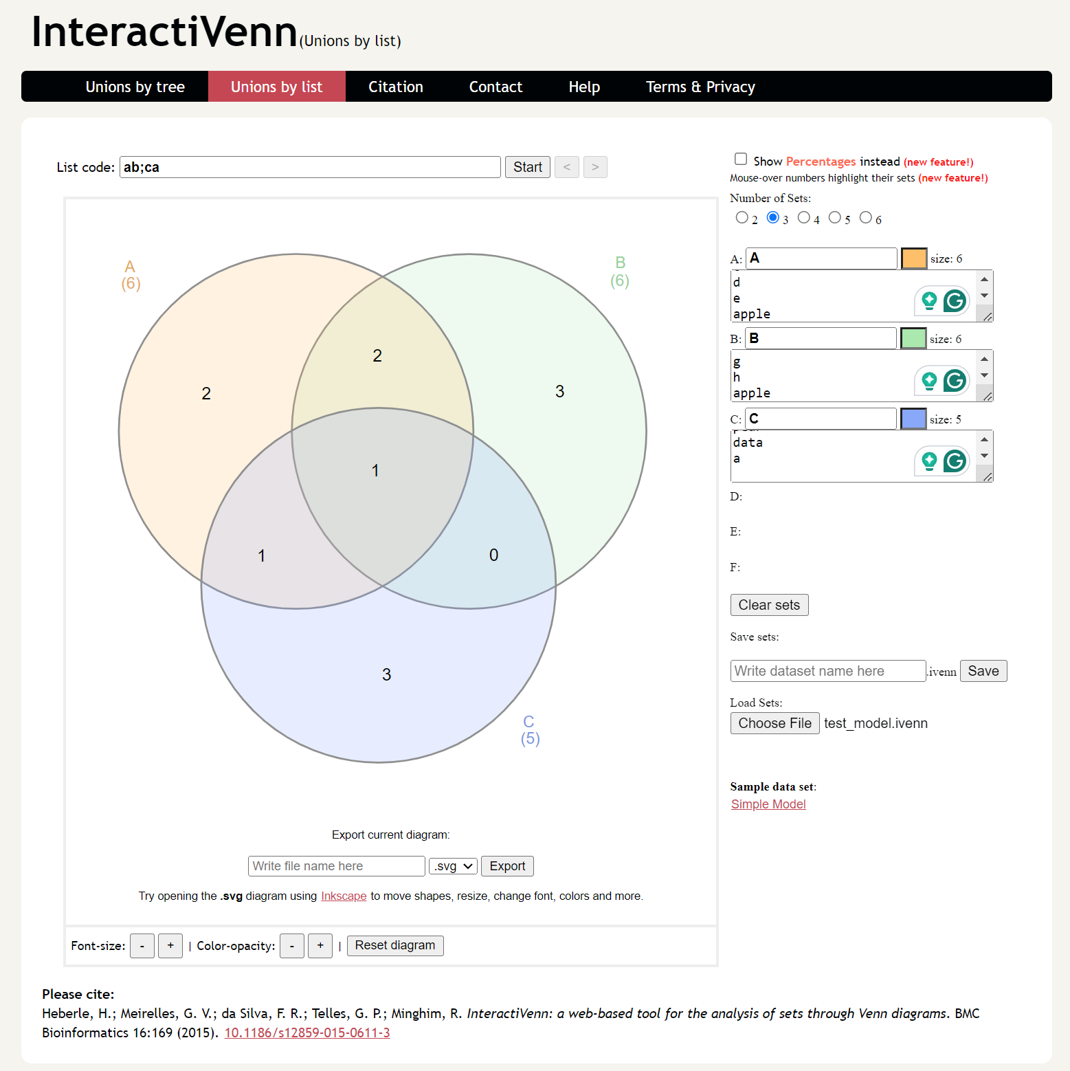
Venn Diagram Software
Canva (canva.com) & Lucid Chart (lucidchart.com)
Provide design templates with a variety of good-looking Venn diagrams. You’ll have to add your own labels, sample items, change nodes sizes, etc.
InteractiVenn (interactivenn.net)
Web app where you can add lists of set members to produce a Venn Diagram. Limited features.

Slide 37
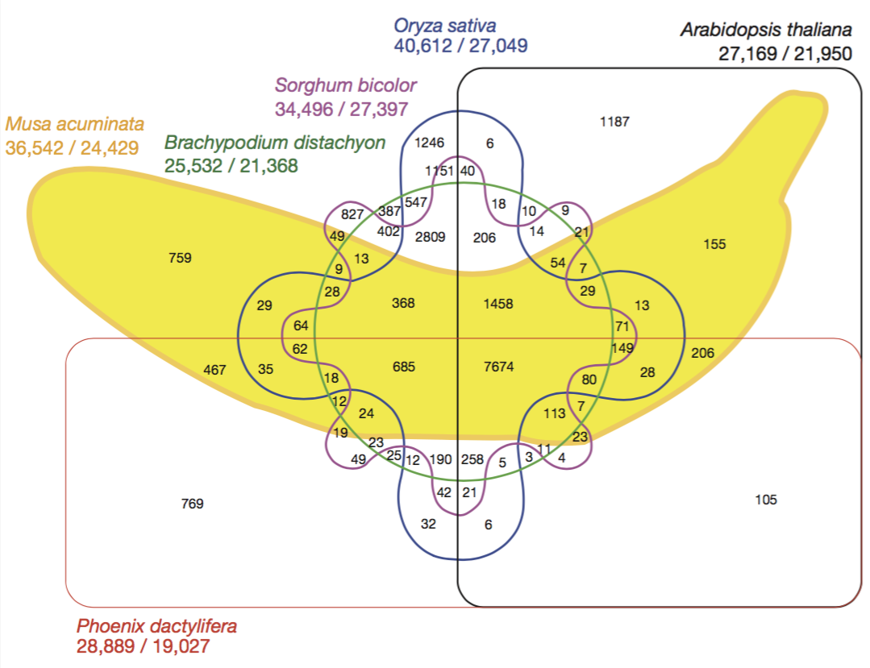
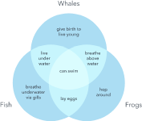
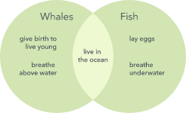
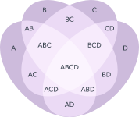
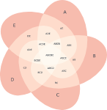
What about more than two sets?
A six-set venn diagram
Overlap in genome between a banana and five other species.
D’Hont, A., Denoeud, F., Aury, JM. et al. The banana (Musa acuminata) genome and the evolution of monocotyledonous plants. Nature 488, 213–217 (2012). https://doi.org/10.1038/nature11241
From https://www.lucidchart.com/pages/tutorial/venn-diagram

Slide 38
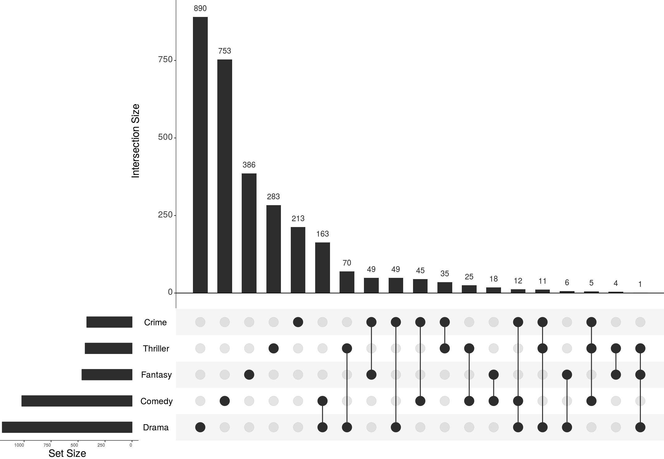
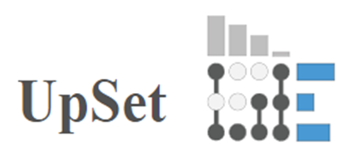
UpSet
Web tool, R library, javascript library, etc.
https://upset.app/implementations/
Images from https://upset.app/

Slide 39
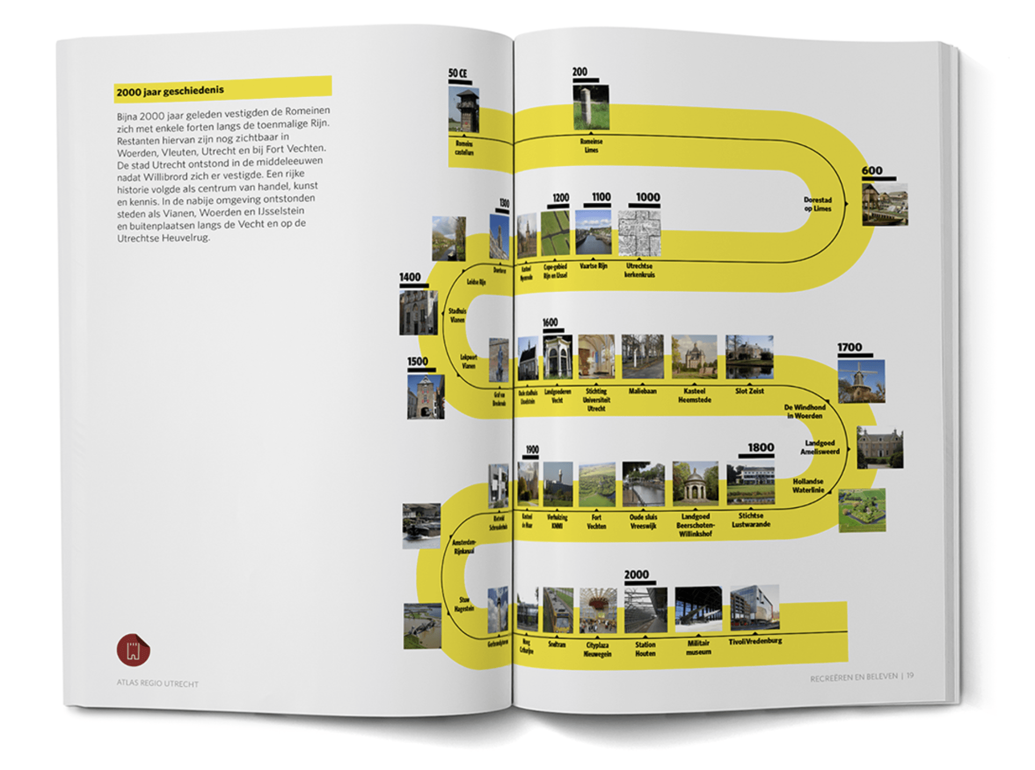
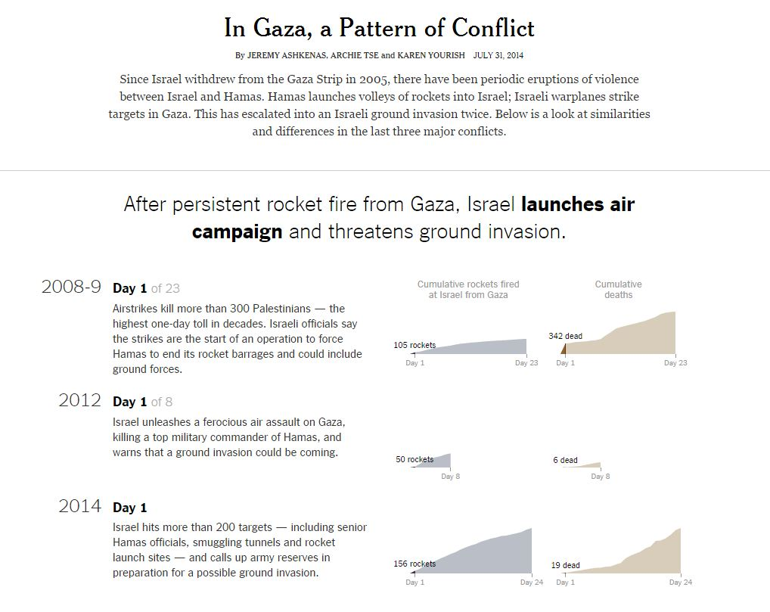
Timelines
https://www.behance.net/gallery/30395075/U10-Atlas-Regio-Utrecht
http://www.nytimes.com/interactive/2014/07/31/world/middleeast/in-gaza-a-pattern-of-conflict.html
Notes:
A Timeline displays a list of events in chronological order. Some timelines work on a scale, while others simply display events in sequence. The main purpose is to communicate time-related information, over time, either for analysis or to visually present a story or view of history.

Slide 40
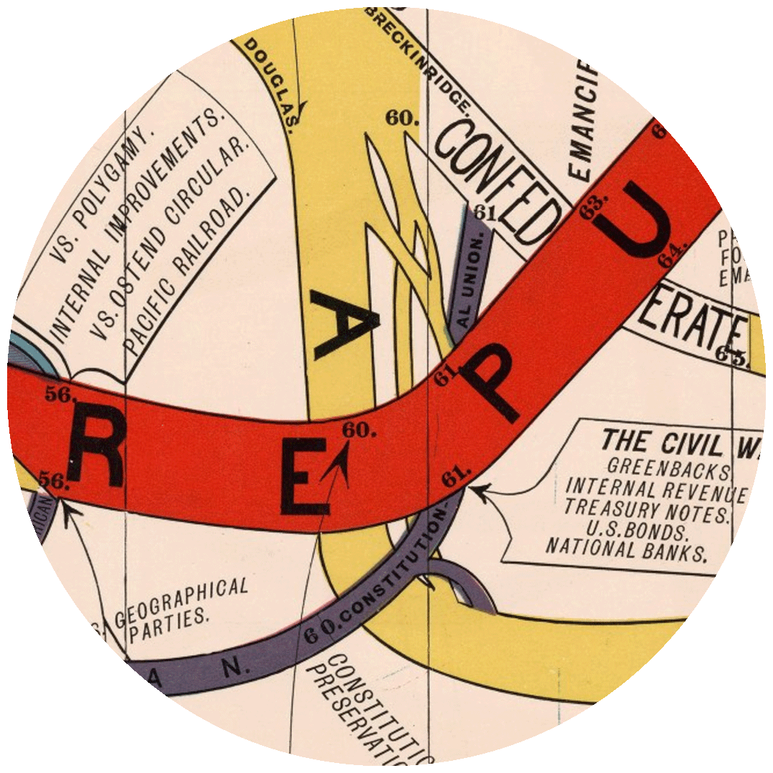
Diagram of the Rise and Fall of American Political Parties
from 1789 to 1880, inclusive
Walter R. Houghton
1880, Bloomington/Indianapolis https://exhibits.stanford.edu/dataviz/catalog/824a049e3319f42ba83eccfdbd6adb41

Slide 41
https://xkcd.com/657/large/

Slide 42
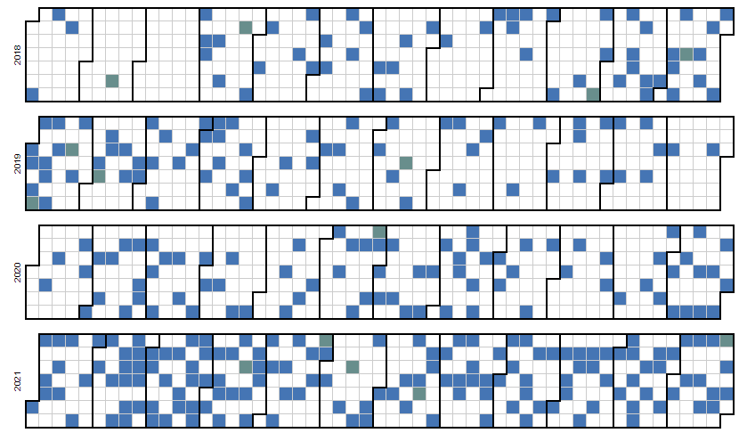

Slide 43
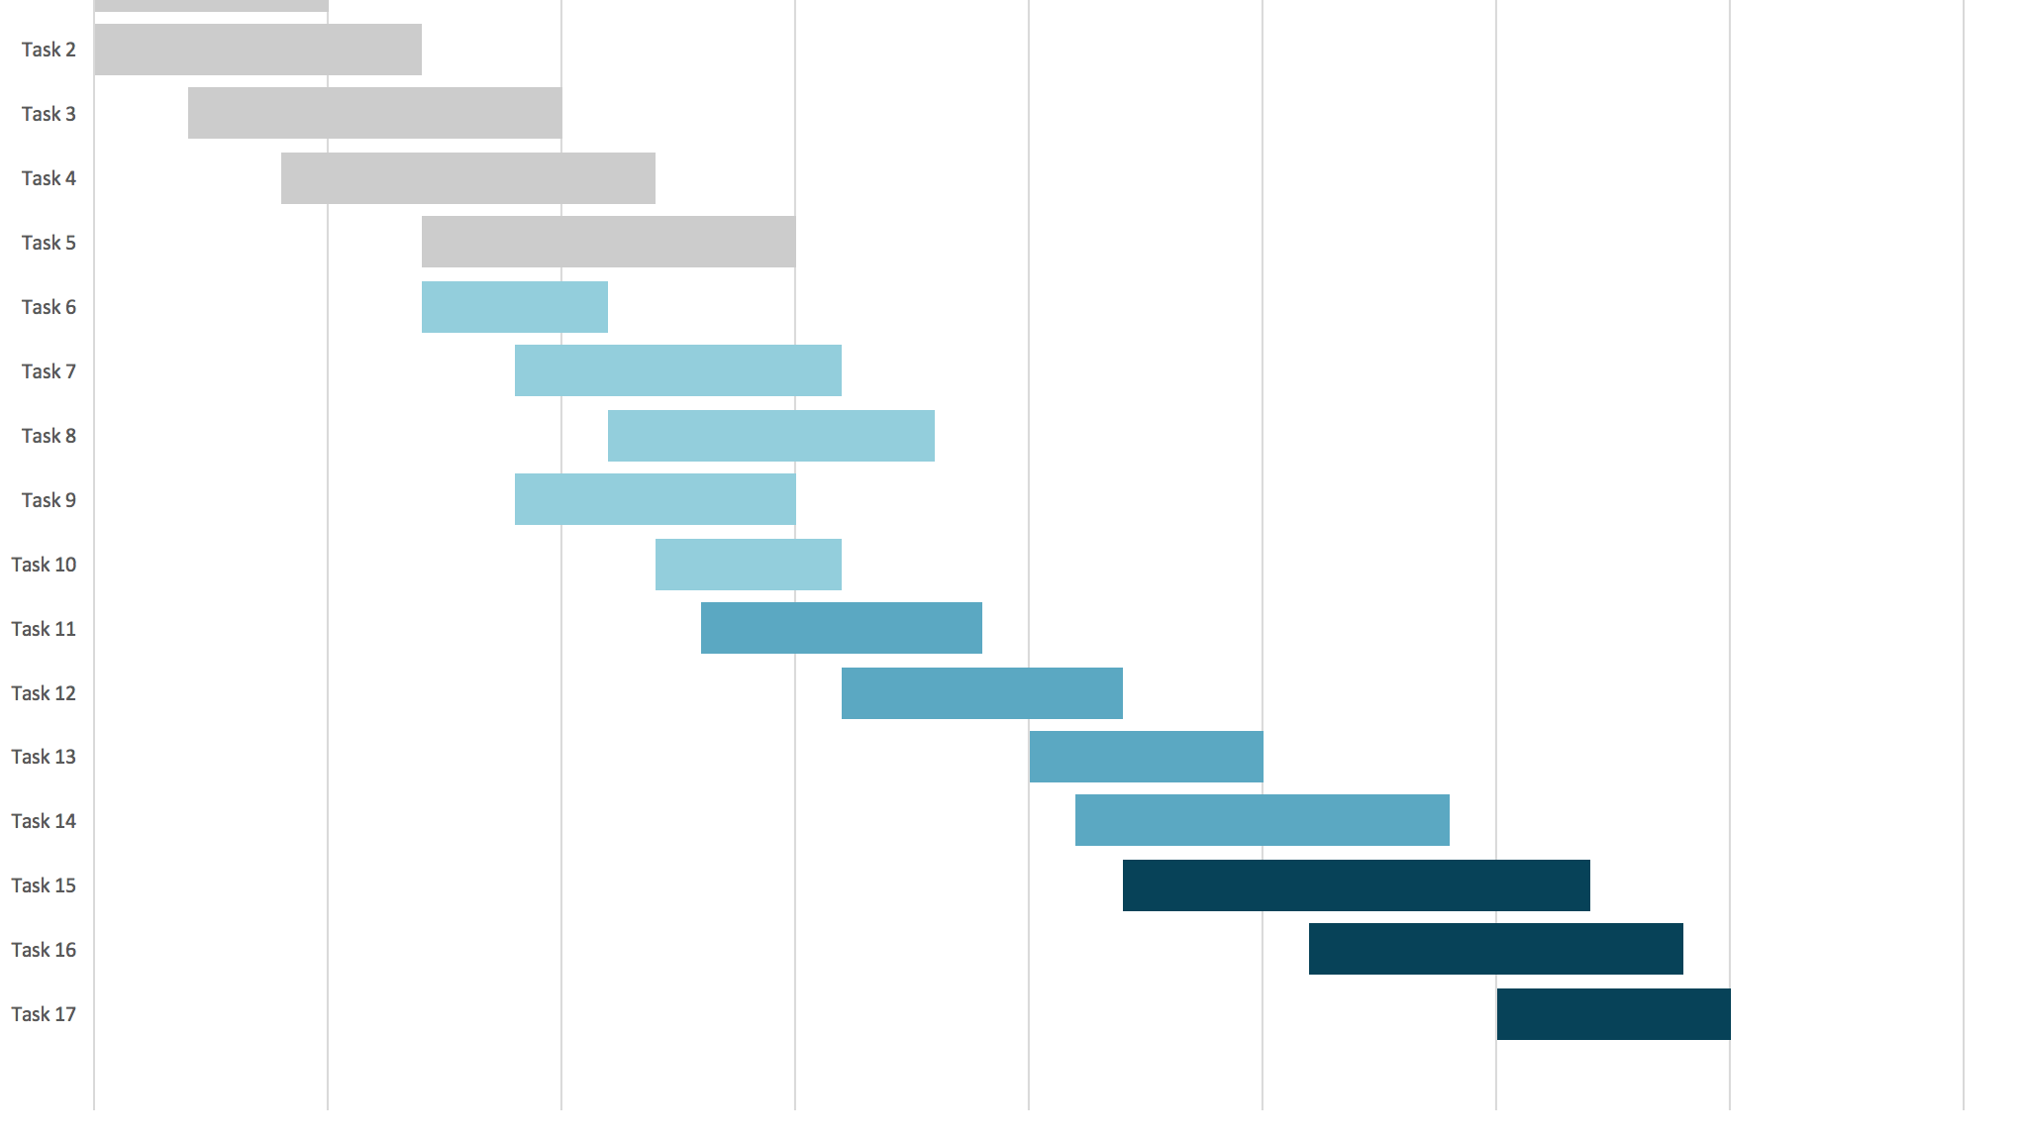
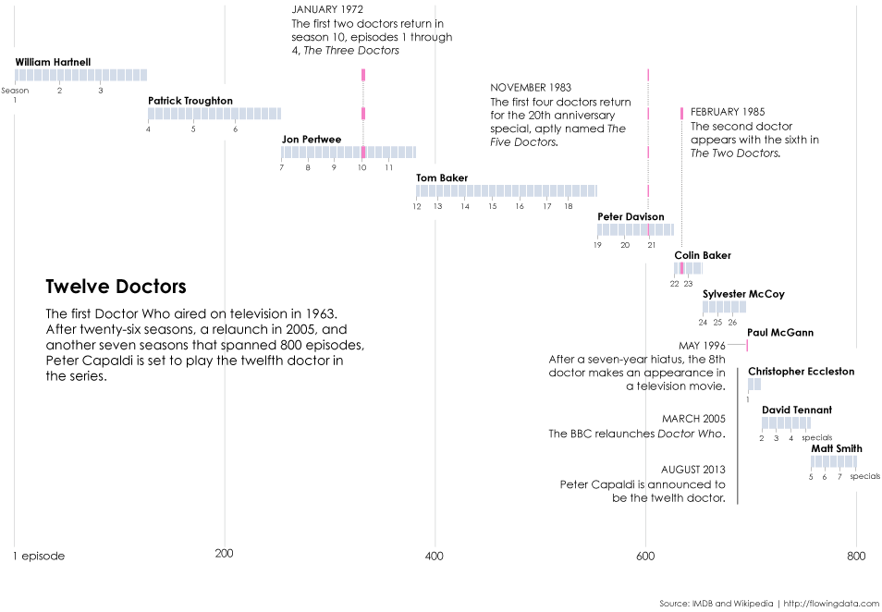
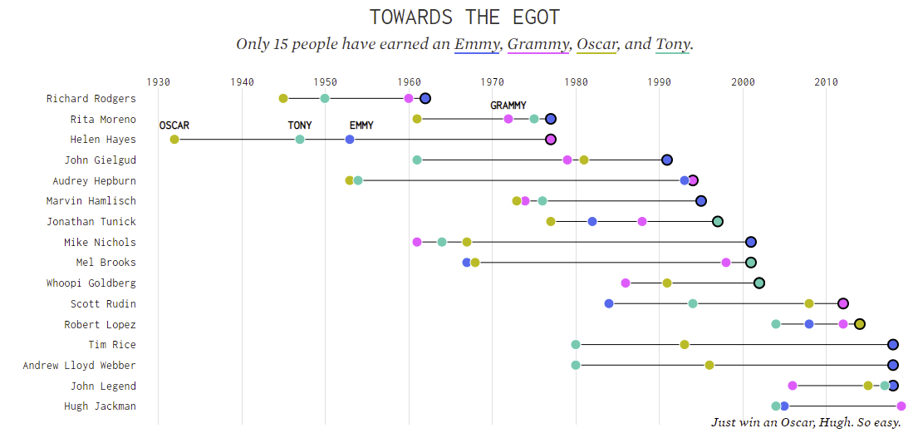
Gantt Chart
Bar chart + timeline
Often used in project management
Each row is an activity, length of bar is duration
Can be created in Excel, Tableau, and many other tools.
https://flowingdata.com/2013/08/05/a-look-back-at-past-doctor-whos/
https://flowingdata.com/2019/02/12/egot-winner-timelines/

Slide 44
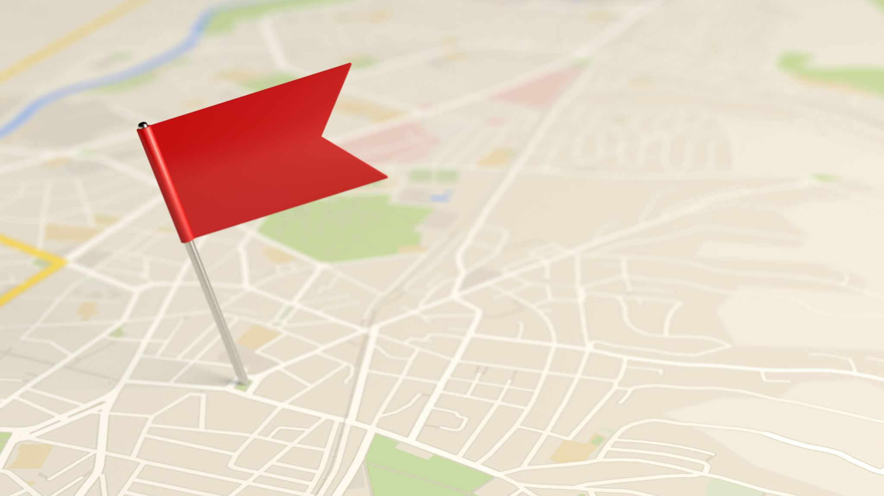
Timeline Tools
TimelineJS http://timeline.knightlab.com/
Fourish https://app.flourish.studio/templates#template-timeline
Google Charts https://developers.google.com/chart/interactive/docs/gallery/timeline
Tiki-Toki Online Timeline Maker https://www.tiki-toki.com/
Time.graphics https://time.graphics/
Vizzlo https://vizzlo.com/create/timeline (watermark)
PowerBI (calendars)
Powerpoint or MS Visio

Slide 45
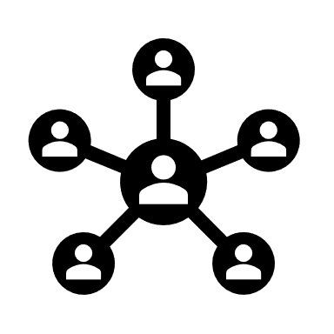
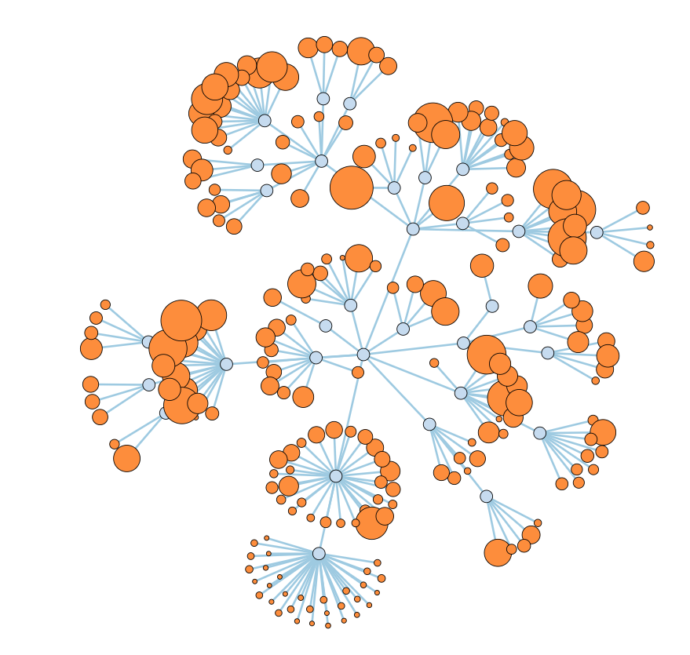
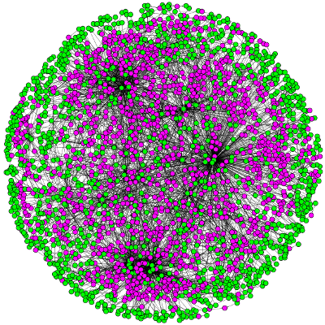
Graphs aka Networks aka Node-Link Diagrams
Used for visualizing relationships.
Nodes can be different shapes as well as coloured or sized based on data attributes.
Edges can be directional and have different widths to reveal properties of the relationship.
Positioning is critical.
https://mbostock.github.io/d3/talk/20111116/force-collapsible.html

Slide 46
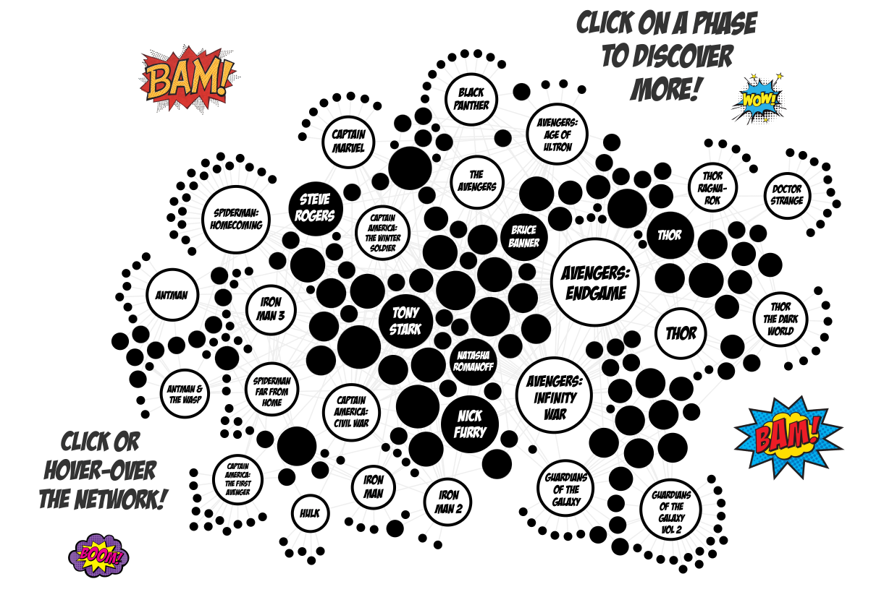
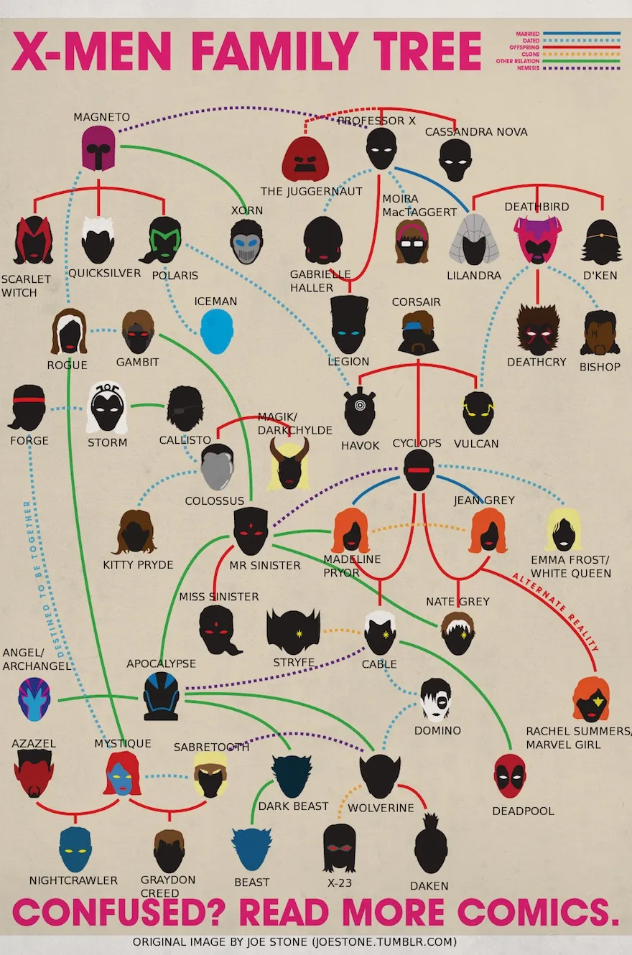
https://marvel.ladataviz.com
https://www.themarysue.com/an-annotated-x-men-family-tree/

Slide 47
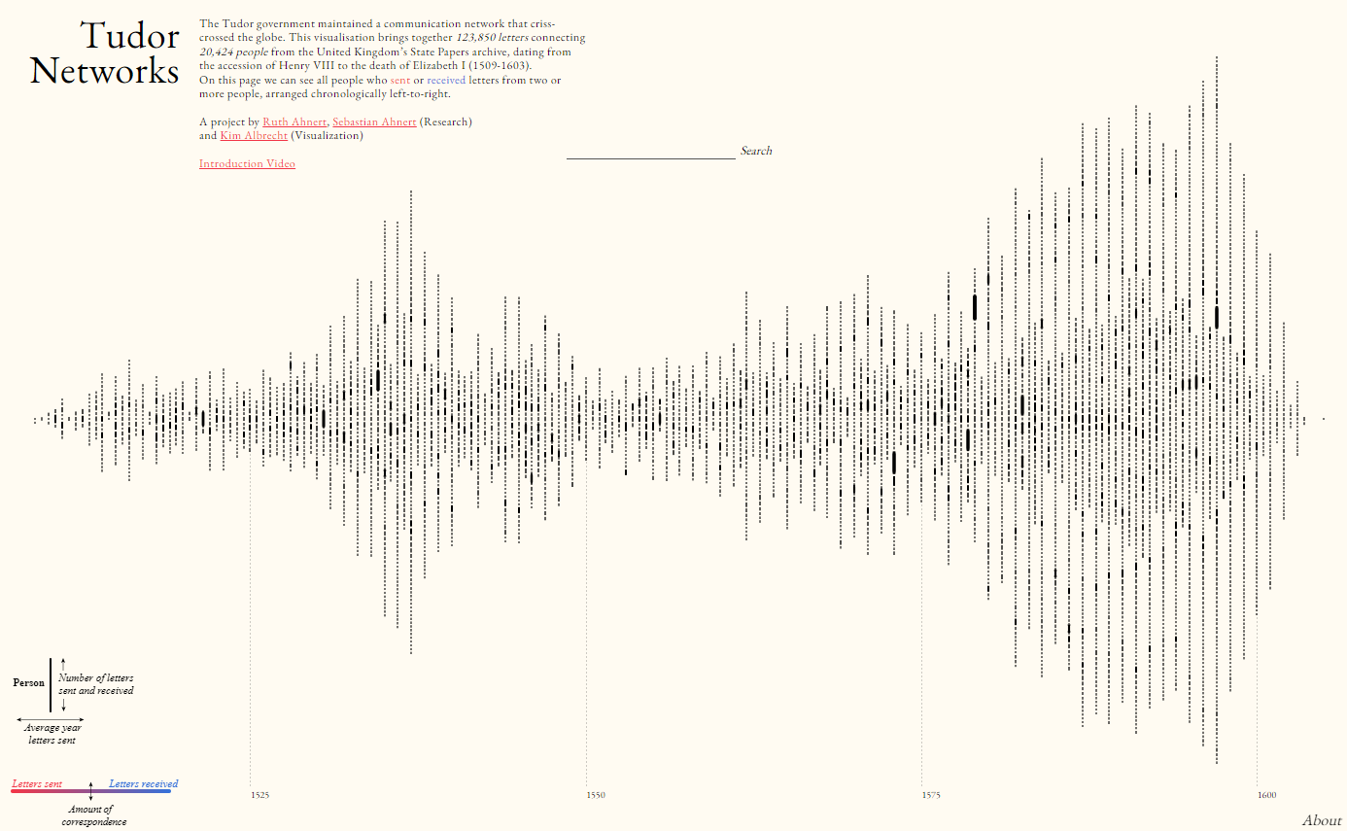
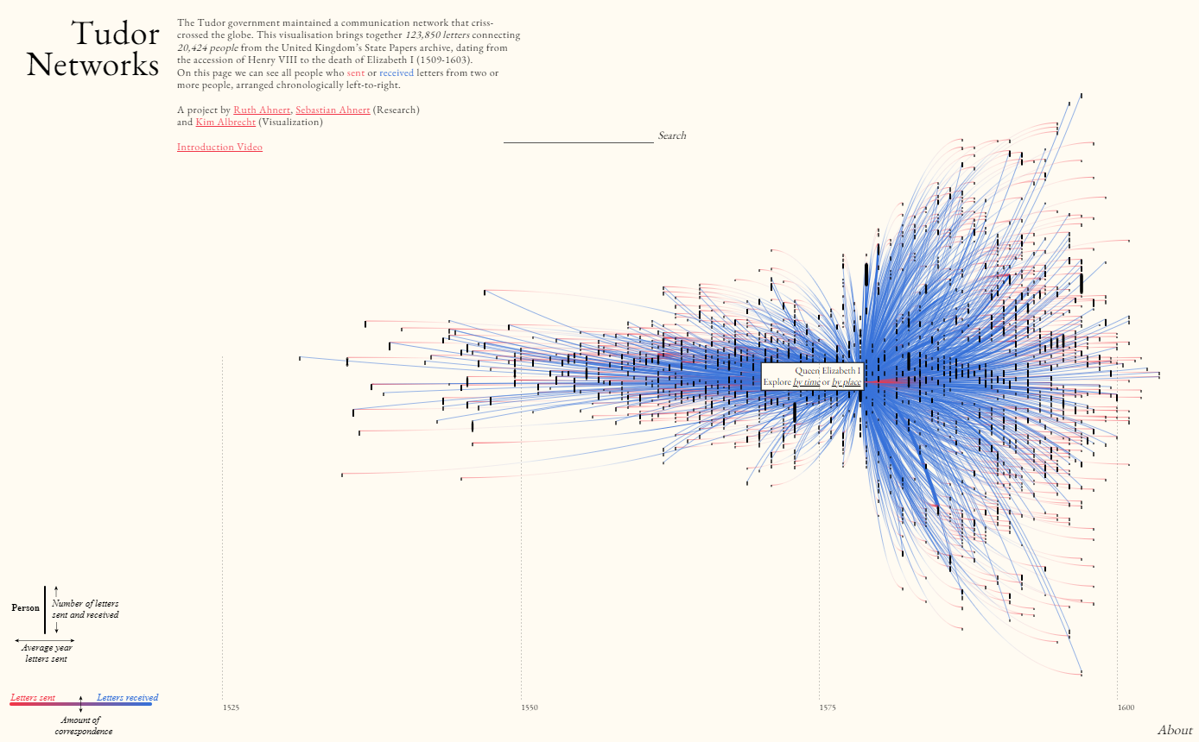
Ruth Ahnert, Sebastian Ahnert, and Kim Albrecht https://tudornetworks.net/

Slide 48
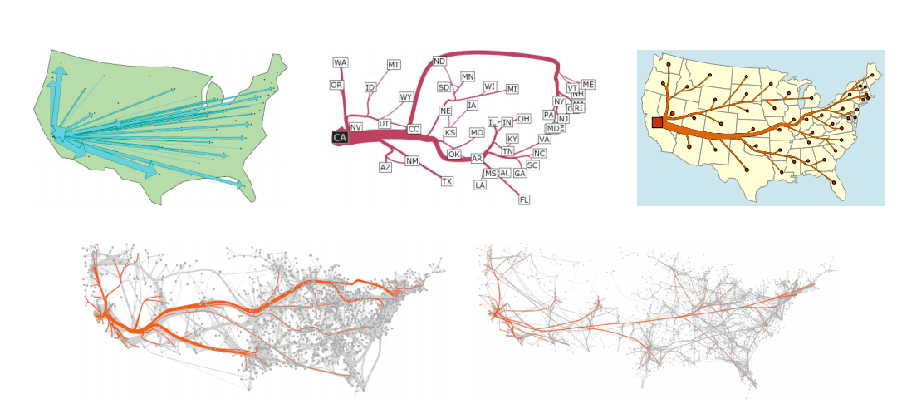
Networks with Map Locations
Choice: Ignore exact locations or not
If not, less freedom
Focus on adjusting edge properties
Migration from California
Tobler 1987
Phan et al. 2005
Verbeek et al. 2011
Cui et al. 2008
Holten & van Wijk 2009

Slide 49
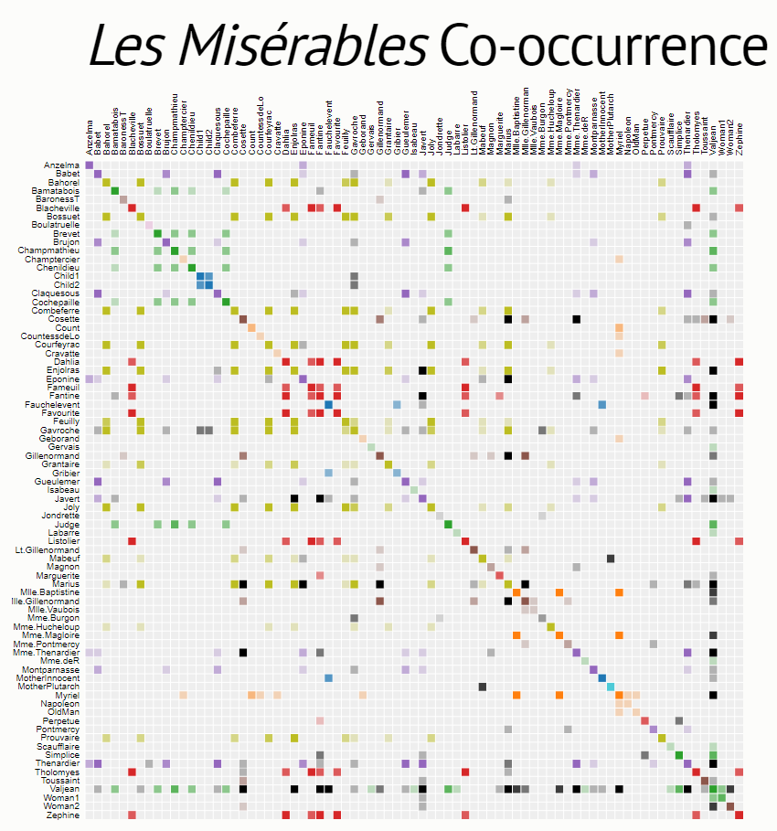
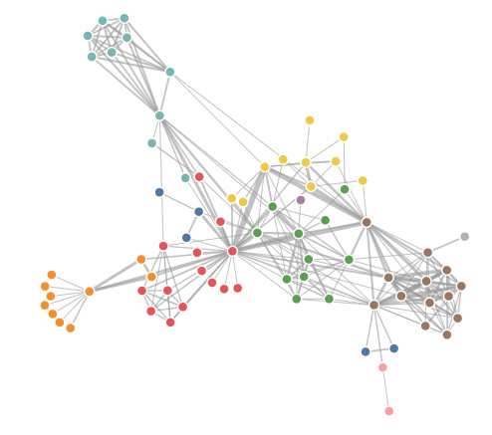
Matrix Networks
https://observablehq.com/@d3/force-directed-graph
https://bost.ocks.org/mike/miserables/

Slide 50
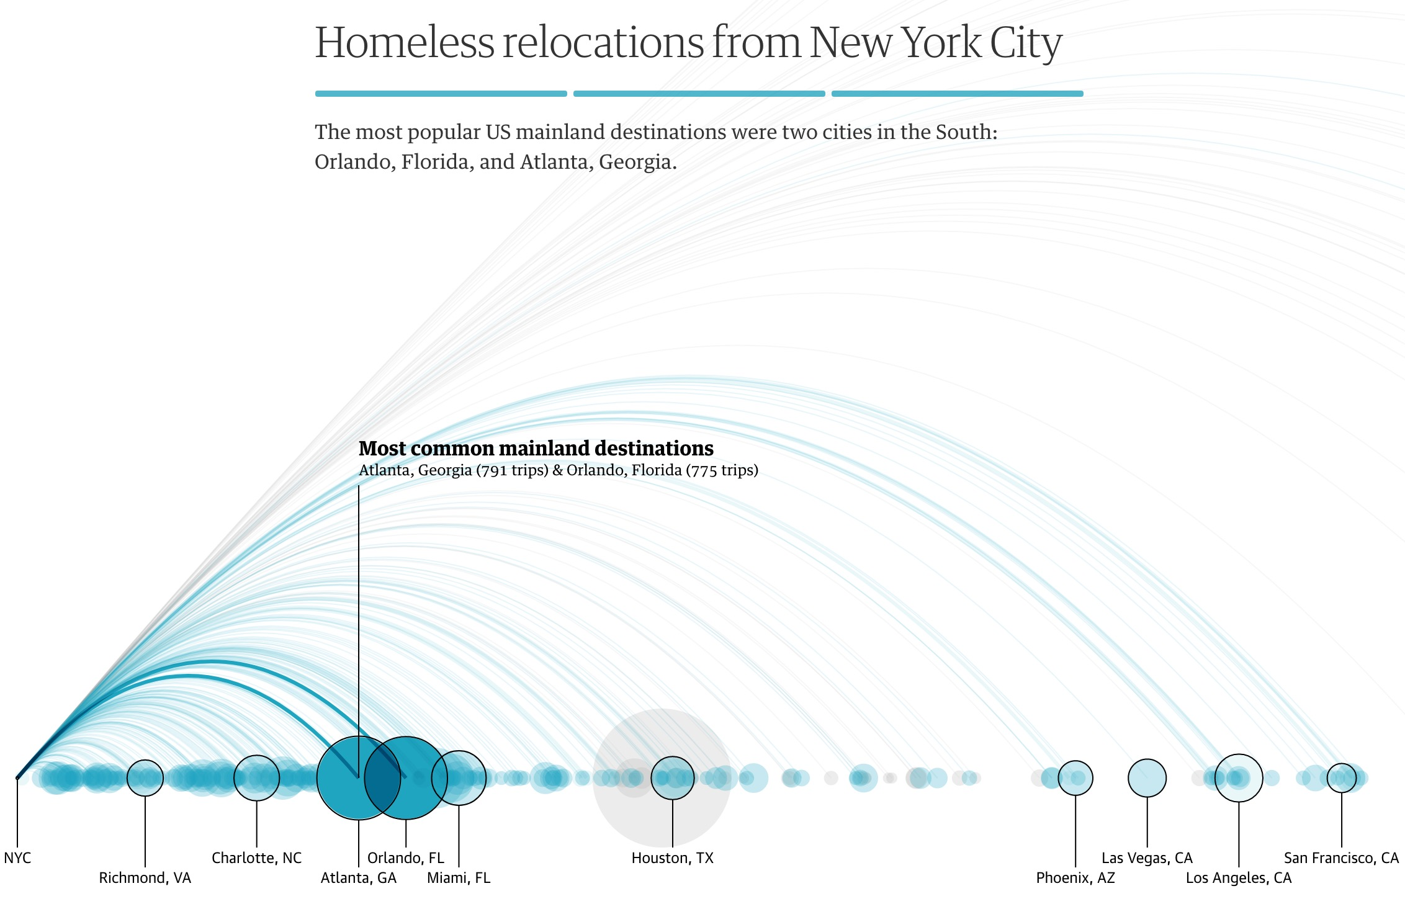
Arc Diagram
https://www.theguardian.com/us-news/ng-interactive/2017/dec/20/bussed-out-america-moves-homeless-people-country-study

Slide 51
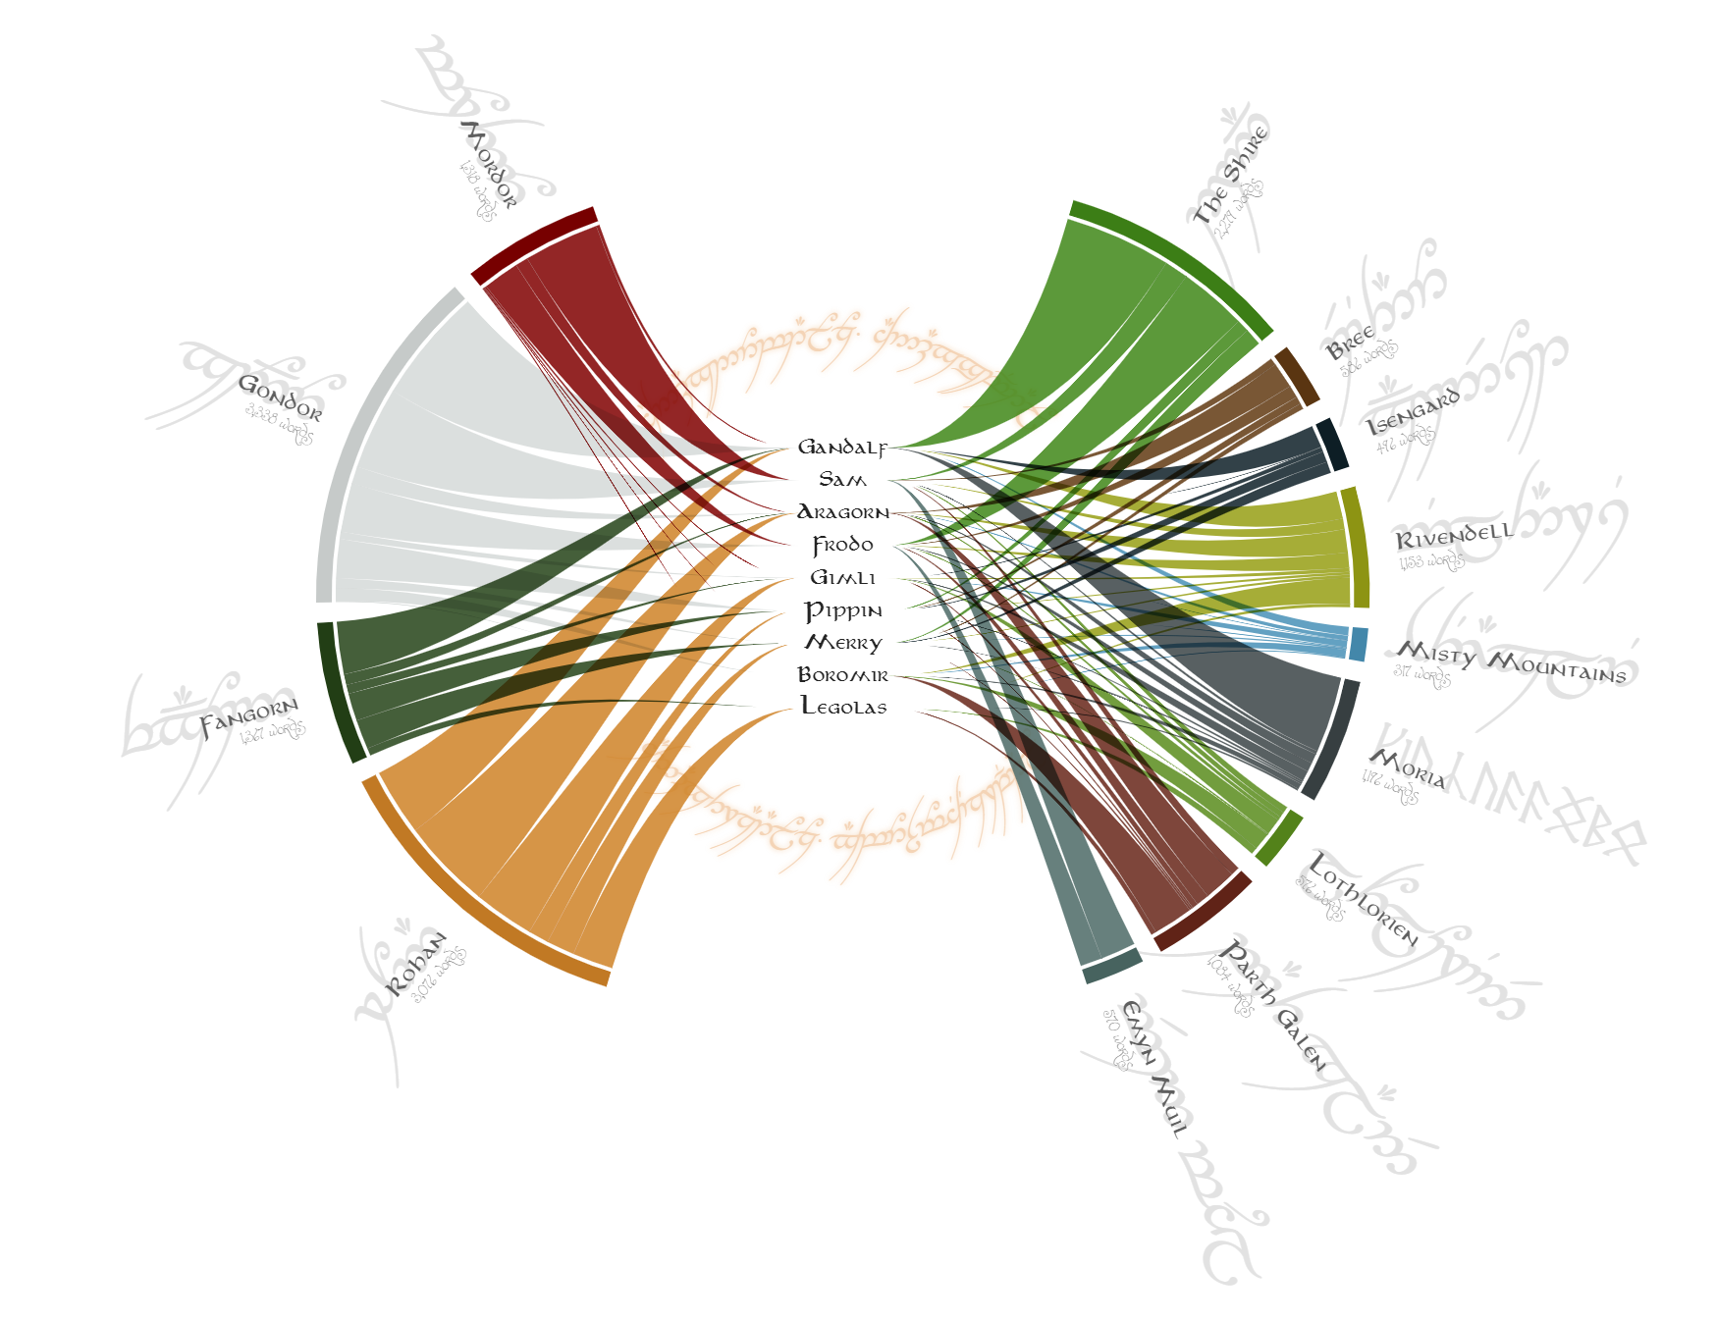

Slide 52
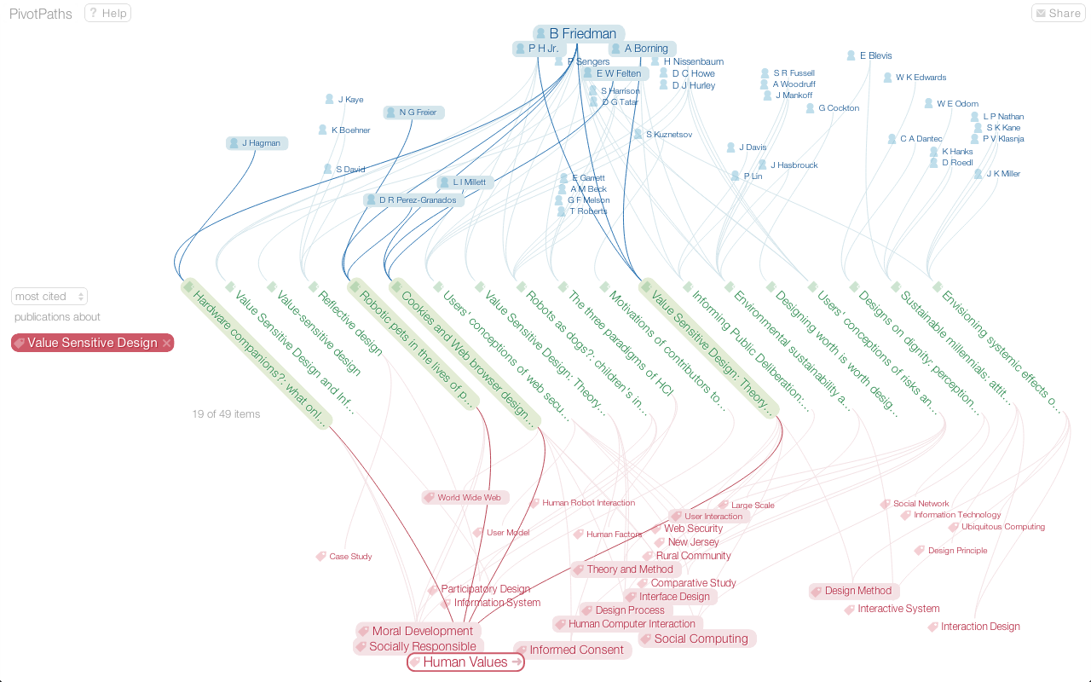
Do you need to see everything?
https://mariandoerk.de/pivotpaths/demo/#/1:0_497686

Slide 53
Trees
Root node
Simple(r) type of graph.
No cycles (loops).
Often used to show hierarchies, family relations/descent, and classification structures.
Types of nodes:
Root
Parent/child
Leaf
Leaf nodes

Slide 54
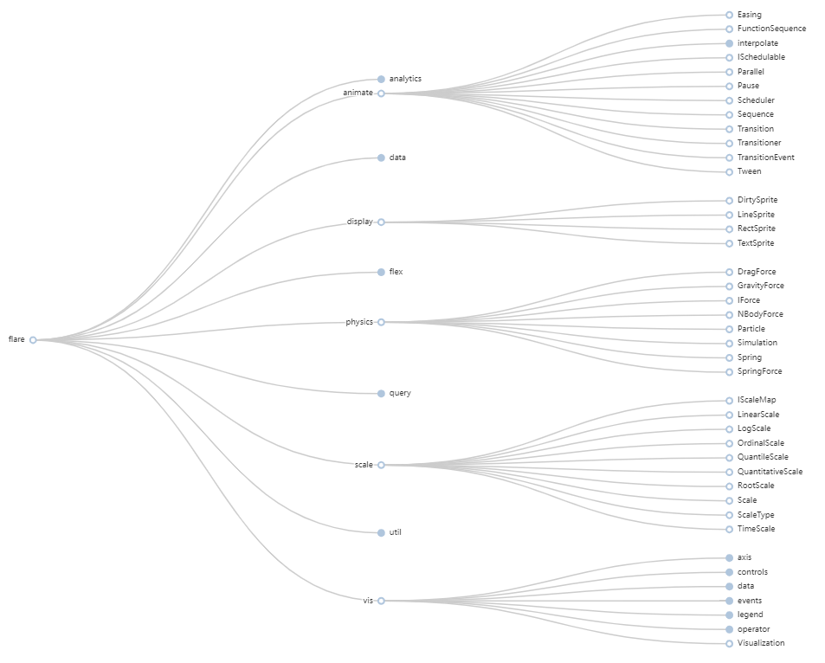
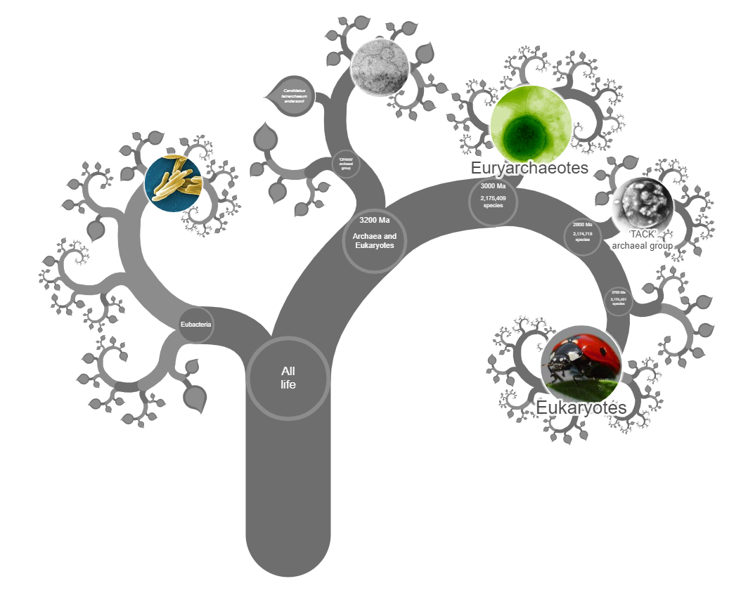
Linear Layouts
https://www.onezoom.org/

Slide 55
Tree created from Google’s
n-gram dataset (three-word phrases)
From https://www.chrisharrison.net/index.php/ Visualizations/WebTrigrams

Slide 56
The common law in the similitude of a tree by R.C. Bierce, 1878. https://www.loc.gov/resource/pga.00530/

Slide 57
Radial Layouts
https://www.lexisnexisip.com/resources/ must-have-patent-visualization-tools/
Nature Photography
https://www.science.org/content/article/first-comprehensive-tree-life-shows-how-related-you-are-millions-species
M. Lima, Book of Trees, p183.

Slide 58
Radial Layout Example
The 200+ Beers Brands of SAB InBev
https://www.maartenlambrechts.com/2015/10/16/interactive-the-200-beer-brands-of-sab-inbev.html

Slide 59
http://stuffofsciencefiction.ca/vis/Wonderverse/
Uta Hinrichs, Stefania Forlini and Bridget Moynihan. Speculative Practices: Utilizing InfoVis to Explore Untapped Literary Collections. IEEE TVCG, 2016.

Slide 60
Paisley Tree
Etemad K, Baur D, Brosz J, Carpendale S, Samavati FF. PaisleyTrees: A Size-Invariant Tree Visualization. EAI Endorsed Trans Creat Tech. 2014.

Slide 61
Make trees by containing areas: TREEMAP
https://observablehq.com/@d3/treemap
Notes:
Emphasizes leaf nodes
Size is equal to number of children
Several variations
Slice n dice (original)
Squarified
Nested

Slide 62
Circle Packing
Visualizing a Software Repository
https://githubnext.com/projects/repo-visualization/

Slide 63
https://treevis.net/

Slide 64
Tools for Graphs & Trees
Applications / Webapps
Gephi, Cytoscape, Circos, NanoHistory, Onodo
Drawing Tools
Powerpoint, MS Visio, Miro, Adobe Illustrator
Code Libraries
D3, ggraph, p5.js, Cytoscape.js, sigma.js, tldraw, Raphael, grano
Treemaps
Tableau, PowerBI, Flourish, Datawrapper
* This is a very small selection of the many tools out there, keep searching if these don’t meet your needs.

Slide 65
Thanks for coming
John Brosz JdlBrosz@UCalgary.CA
Slides: brosz.ca/slides

Slide 66
End of Run Through

Slide 67
DV CoP Discussion
What have you or others you know have done? Differences? Activities/Exercises?
Any types/categories of qualitative visualizations missed?
Missing software/tools?
Plan for a “how to make prettier NVIVO visualizations” workshop.
Other Ideas?

